Slide 1
BERTPlus - Optimize BERT Model Embeddings for Question Answering in Low Data Regime
Ed Brown, Ray Cao and Lisa Wu
W266 NLP Summer 2023
Notes:
Opening remarks - [Speaker: Ed Brown]
BERTPlus where we set out to optimize BERT performance in the Low Data Regime for Question and Answer datasets.

Slide 2
Motivation and Problem Definition
BERT advanced the state-of-art in the NLP world!
However, fine tuning BERT is costly and requires high power GPU/TPU
Also, low training data regime may not work effectively for fine tuning
Recent works discovered feature extraction from BERT to leverage rich information in hidden states
We propose BERTPlus, a data and parameter-efficient solution to use a target set of hidden layers and reduce fine tuning needs
Notes:
[Speaker: Ed Brown]
BERT Large Uncased consists of ~335 Million parameters. This creates a couple of issues for fine tuning the model.
The first is that it requires access to expensive hardware to tune the model in a reasonable amount of time.
Additionally, when working with a small training set. There may not be enough data to sufficiently fine tune BERT for the desired performance
We chose address these issues by leveraging recent works which suggest that there is additional information to be extracted from BERTs hidden states.

Slide 3








High Level System Architecture
Data Load & Process
Model Execution
Output Process
SQuAD v2.0 Q&A
HPC GPU Node 3x Nvidia A100
Dev-V2.0
Train-V2.0
Apptainer
Squad V2 Processor
weights
BERT (Large, Uncased)
386, 128, 48
Average Pooler Model
EM /
F1
Learned Pooler Model
scores
evaluate.py
Train / Dev (SQuaAD)
Train / Validation (IMDB)
Accuracy /
curLoss
512, N/A, 30
Target Pooler Models
File Directory
ebrown/nlp-gpu-jupyter:1.6.8
weights
Test
Train
IMDB.
vocab
Notes:
[Speaker: Ed Brown]
Our primary dataset used for evaluating the models was the SQuAD 2.0 Q&A dataset.
This data was passed through tokenization and cached before loading into models for training.
This greatly reduced the time required to train each model.
Each model at 20 40 60 80 and 100 percent of the Squad dataset then up to six epochs to understand the effectiveness of our models for different training data sizes. Each models weights and results were then archived for later evaluation.
Resulting in an analysis of over 50 model/weight combinations.
Ray will now talk to you about our model development.

Slide 4
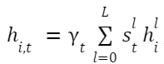
Model Evolution
Baseline BERT
(Large, Uncased)
Average Pooler Model
Learned Pooler Model
Can we optimize Selection?
Trained on 3.3 billion English words
335K parameter
16 Attention Heads
24 Encoder Layers
Extracted the weights of all layers of the baseline model
Apply uniform weights to linearly combine embeddings of all 25 layers into a single set of vectors
Instead of equal weight for each layer, implemented the learned pooling method ¹
Questions:
How do weights distribute among the layers?
How do these weights change by epoch?
The learned pooling method was described in Peters et al. 2018a paper. 𝜸_{t} is the scalar of parameters and S_{t} is the softmax of the encoder weights
Notes:
[Speaker: Ray Cao]
Like Ed said, we started with the 25 hidden layers, and generated embeddings from each of them
Then, we first tried to average all these embeddings, and see if this helps with the prediction.
Then we thought about this: rather than using the equal weights, we changed these weight to be learnable, to allow the model learn from the difference of importance of each layer.
From there, we did further analysis on these learned weights, and try to understand:

Slide 5
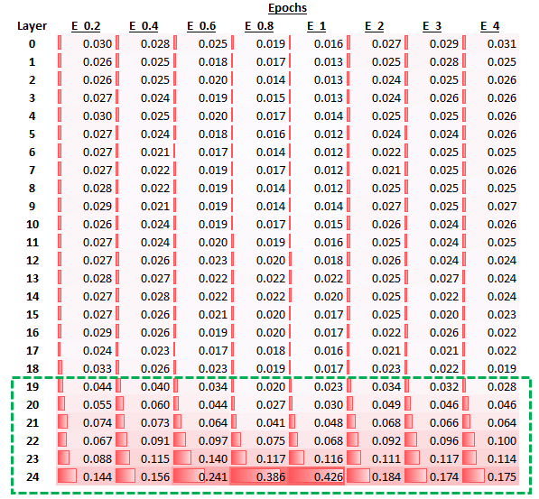
What did we observe in hidden states for SQuad 2.0?
Later Layer
Higher Weights
Notes:
[Speaker: Ray Cao]
This is a summary of the full learned weight from each hidden layer.
Apparently, the later layers contribute more heavily to the final results, which is as expected - given the original BERT prediction was generated using ONLY the last layer.
We can also see weights are somewhat consistent across different epochs.
From here we derived 2 models:
Take the top 12 layers that contribute the most to the final predictions, from each epoch.
Take the last 6 layers - which are consistently the most important layers as highlighted. They consistently contribute over 50% to the final results.

Slide 6
Our Best Model T-6
BERT _{large, Uncased}
Extract Layers
Learned Weights
Compress and Dense
Full 25 Layers
Concatenate Embeddings
(N, 386, 1024)
(6, )
Encoder Layer 24
Input Layer 0: (N, 386, 1024, 1)
Lay 1-24: (N, 386, 1024, 24)
Encoder Layer 19
Dense(N, 2, 386)
Target Six Layers
Span Start
Encoder Layer 2
Lay 19-24: (N, 386, 1024, 6)
Span End
Encoder Layer 1
Input Embedding Layer 0
Training Embeddings:
(131911, 386, 1024, 6)
Y_{t} is the scaler
S_{t} is the softmax of the encoder weights
Notes:
[Speaker: Ray Cao]
This is the framework we used to implement the model. I use the T6 model as an example.
We started from the left: After fine-tuning the bert large model, we freeze its weights and extracted the embeddings generated from the last 6 hidden states (in the second column).
Then we feed it through our learned pooler layer (in the middle), and then to generate the final predictions
We did this for multiple different BERT models trained up to different epochs or partial epochs, to understand how to optimize the learning with limited training resources and data.
Now I will pass on to Lisa to explain our results

Slide 7
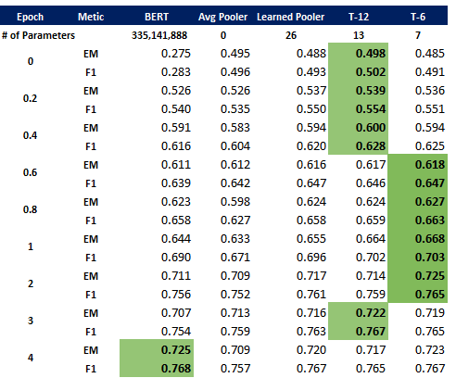
Model Performance Comparison
1) Model parameters efficient
2) T-12 and T-6’s EM and F1 scores led the pack
3) T-6 achieved BERT’s best scores with 2 fewer epochs
Notes:
[Speaker: Lisa Wu]
Thank you, Ed and Ray. Next I will compare the model results
I won’t dive into all the details but focus on the key contributions of our Target Pooler Models, which are the last two columns on the right.
The first key contribution is model parameter efficiency. As Ed and Ray mentioned, BERT has $335M parameters, but our Target Pooler models froze these parameters and only needed to learn weights for the top 12 or 6 layers, which is a great efficient gain.
We performed 4 partial and 4 full epoch training for each model. The key benefit of partial epoch training is to mimic learning in low data regime and evaluate how the model performs with limited data.
Our T-12 and T-6 models consistently outperformed the baseline BERT model through Epoch 3, as highlighted in green shade in the last two columns.
Lastly, the T-6 model achieved BERT’s best performance with 2 fewer training epochs and achieved our goal of minimizing fine tuning work

Slide 8
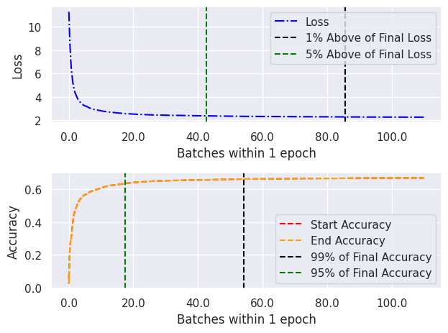
Model Loss and Accuracy Curve
T-12 Model
4/10 of epoch achieved ~95% of the final loss reduction
2/10 of epoch achieved ~95% of the final accuracy result
Notes:
[Speaker: Lisa Wu]
One important exploration is to understand how our models reduce loss throughout the training.
As you can see from the loss curve at the top. Our Target Pooler Models achieved 95% of the total loss reduction with only 40% training data, where the green arrow points to
The accuracy chart at the bottom shows that our Target Pooler Models achieved 95% of the final accuracy level with only 20% training data.
This is another way to demonstrate how our best model achieved strong performance with a fraction of training data and minimal fine-tuning work

Slide 9
Conclusion
Future Work
Future Work
T-6 achieved BERT’s global best EM and F1 score with 2 fewer fine-tuning epochs
T-6 enables training exploration with a fraction of data, before any full epoch fine-tuning
Our efficient data processing method reduced data loading and minimized training time, for any models that involve manipulating BERT hidden states.
For the unanswerable questions in SQuad 2.0, the prediction accuracy started high (>85%), but did not improve further with more training data and epoch.
More analysis and techniques can be leveraged to improve unanswerable questions in future works.
Notes:
[Speaker: Lisa Wu]
To sum it up, our proposed T-6 model is data and parameter efficient and achieved BERT’s global best performance with 2 fewer epochs
This model also provides great flexibility for users to explore modeling techniques with a fraction of data, before investing resources to conduct any full epoch fine tuning work
As for future work, we noted that both BERT and our best model performed very well for the questions with answers. However, for questions without answers, the accuracy was high at the start of the training, but more training data or epochs did not push the performance higher. So we think this will be an area to spend more time in analysis and modeling techniques in future works.
That concludes our presentation and we are happy to take any questions.

Slide 10


